Slide 1
Introduction to Hardware – Additional Information
For
CSIS 2260 Operating Systems
and
CSIS 2270 Virtualization and Computer Networks

Slide 2
PC Hardware Components
Input/output (I/O) devices: external to the case
Processing, storage devices: internal to the case
Central processing unit (CPU)
Also called: processor, microprocessor
Reads input, processes data, writes data to storage
Elements required by I/O, storage devices
CPU communicate with the device
Software to instruct, control the device
Electricity to power the device

Slide 3
Hardware Needs Software to Work
Hardware
Computer’s physical components
Monitor, keyboard, memory, hard drive
Software
Instruction set
Directs hardware to accomplish a task
Uses hardware for four basic functions
Input, processing, storage, output
Hardware components
Require an electrical system

Slide 4
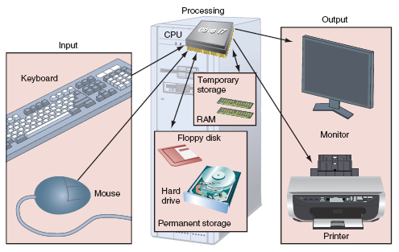
Figure 1-1 Computer activity consists of input, processing, storage, and output
Courtesy: Course Technology/Cengage Learning

Slide 5
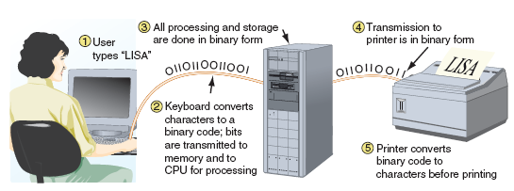
Hardware Needs Software to Work (cont’d.)
User interaction with computer
User and software communicate with input device
Hardware uses two states: on and off
Figure 1-2 All communication, storage, and processing of data inside a computer are in binary form until presented as output to the user
Courtesy: Course Technology/Cengage Learning

Slide 6
Hardware Needs Software to Work (cont’d.)
Binary number system
Stores and reads two states
Zero or one
Bit: binary digit
Value of zero or one
Byte: eight bits
Used for counting, calculation, storage operations
American Standard Code for Information Interchange (ASCII)
Used for storing information

Slide 7
Hardware Used for Input and Output
I/O device communication with computer components
Cabled using a port
Port - access point located in back or front of case
Wireless
Primary input devices
Keyboard, mouse
Requires electricity from inside case
Primary output devices
Monitor: visually displays primary computer output
Printer: produces paper output (hard copy)

Slide 8
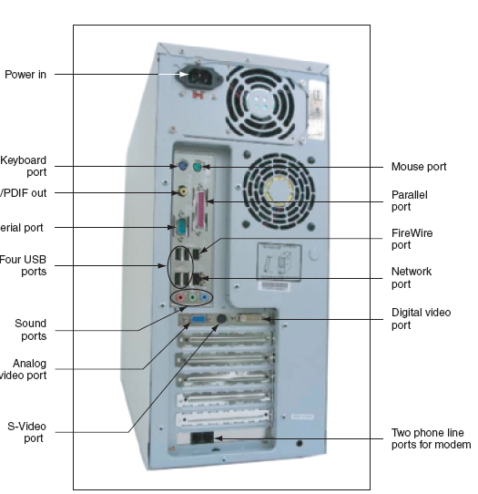
S
Figure 1-4 Input/output devices connect to the computer case by ports usually found on the back of the case

Slide 9
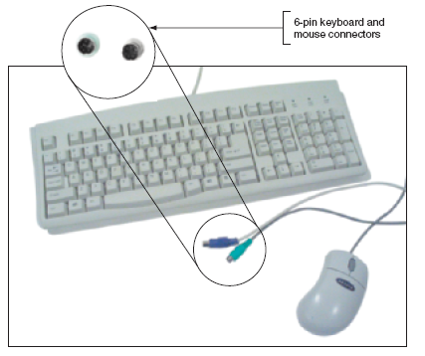
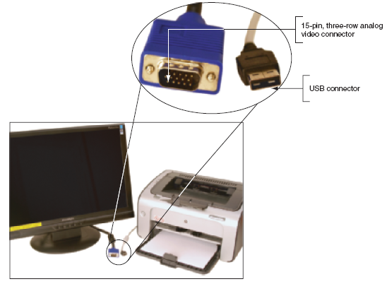
Figure 1-5 The keyboard and the mouse are the two most popular input devices
Courtesy: Course Technology/Cengage Learning
Figure 1-6 The two most popular output devices are the monitor and the printer
Courtesy: Course Technology/Cengage Learning

Slide 10
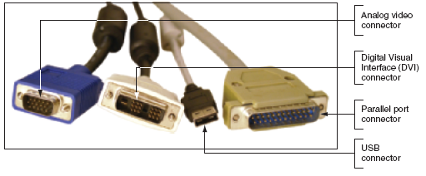
Figure 1-7 Two video connectors and two connectors used by a printer
Courtesy: Course Technology/Cengage Learning

Slide 11
Hardware Inside the Computer Case
Storage and processing occurs in the case
Internal devices common to most computers
Motherboard containing CPU, memory, other parts
Hard drive, optical drive for permanent storage
Power supply with power cords supplying electricity
Adapter cards for internal and external communication
Cables to connect devices
Adapter card installed in expansion slots
Cable types
Data (communication) and power

Slide 12
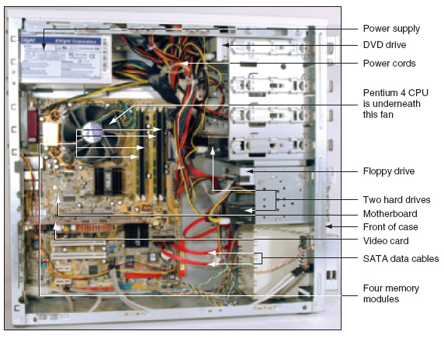

Slide 13
The Motherboard
Largest, most important circuit board
Main board or system board
Contains the CPU, expansion slots, other devices
Motherboard component categories
Processing, temporary storage, communication, power
All devices communicate with motherboard CPU
Peripheral device links to motherboard via cable
Motherboard ports may be outside of the case
Keyboard, mouse, parallel, USB ports, sound ports

Slide 14
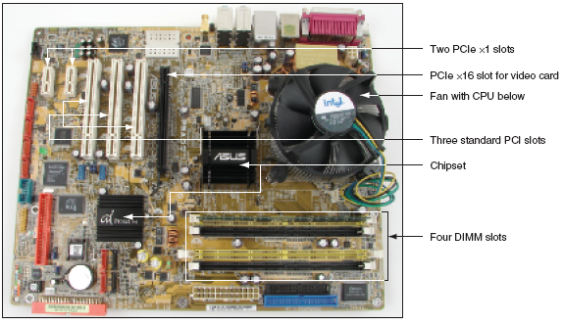
Figure 1-9 All hardware components are either located on the motherboard or directly or indirectly connected to it because they must all communicate with the CPU
Courtesy: Course Technology/Cengage Learning

Slide 15
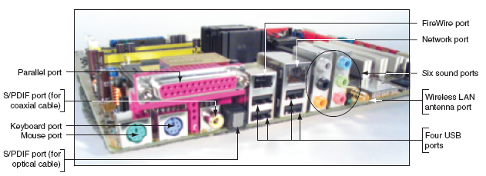
Figure 1-10 A motherboard provides ports for common I/O devices
Courtesy: Course Technology/Cengage Learning

Slide 16
The Processor and the Chipset
CPU
Chip inside the computer
Performs most data processing
Chipset
Group of two microchips controlling data flow
Major CPU, chipsets manufacturers
Intel Corporation, AMD

Slide 17
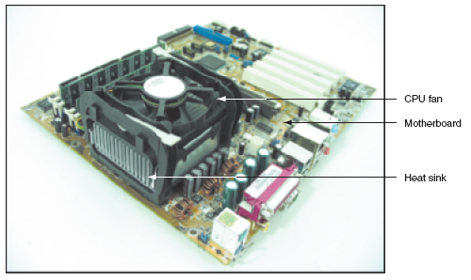
Figure 1-11 The processor is hidden underneath the fan and the heat sink, which keep it cool
Courtesy: Course Technology/Cengage Learning

Slide 18
Storage Devices
Primary storage (main memory)
Temporary (volatile) storage used by the processor
High data access speed
Secondary storage (permanent storage/non-volatile)
Enables data to persist after machine turned off
Higher capacity but slower access speed
Examples: hard drive, CD, DVD, USB drive

Slide 19
Primary Storage
Provided by random access memory (RAM)
Located on motherboard, adapter cards
RAM chips
Embedded on small board
Plugs into motherboard
Most common: dual inline memory module (DIMM)
Video memory: embedded on video card
Volatile memory

Slide 20
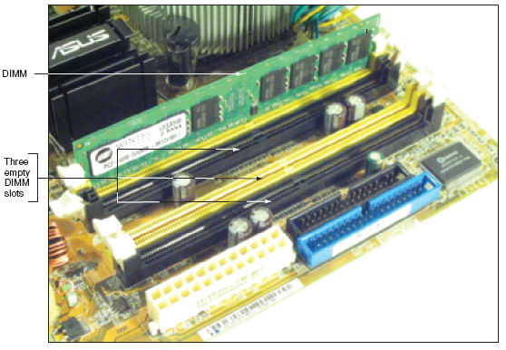
Figure 1-13 A DIMM holds RAM and is mounted directly on a motherboard
Courtesy: Course Technology/Cengage Learning

Slide 21
Secondary Storage
Remote storage locations containing data and instructions
Cannot be directly processed by CPU
Permanent (nonvolatile)
Hard drives
Main secondary computer storage device
Magnetic hard drives
Use Integrated Drive Electronics (IDE)
Solid state drive (SSD)
Use nonvolatile flash memory

Slide 22
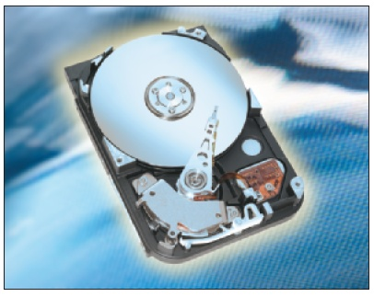
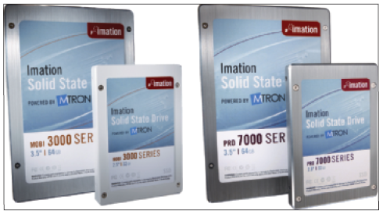
Figure 1-15 Hard drive with sealed
cover removed
Courtesy: Seagate Technologies LLC
Figure 1-16 Four SSD drives
Courtesy: Course Technology/Cengage Learning

Slide 23
Secondary Storage (cont’d.)
Hard drives (cont’d.)
ATA (Advanced Technology Attachment) standard
Specifies motherboard-hard drive interface
Types: serial ATA (SATA), parallel ATA (PATA)
Serial ATA standard
External SATA (eSATA)
Usually two to eight SATA and eSATA connectors
Parallel ATA (PATA)
Slower than SATA
Two connectors on a motherboard for two data cables
Accommodates up to four IDE devices

Slide 24
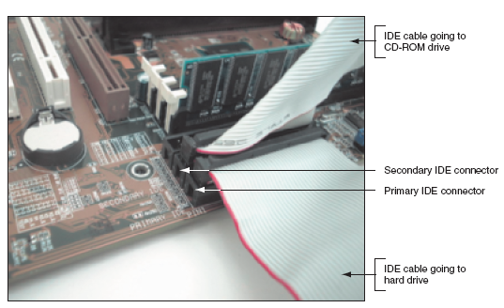
Figure 1-18 Using a parallel ATA interface, a motherboard has two IDE connectors, each of which can accommodate two devices; a hard drive usually connects to the motherboard using the primary IDE connector
Courtesy: Course Technology/Cengage Learning

Slide 25
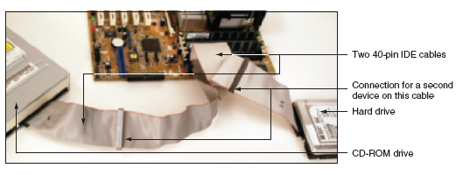
Figure 1-19 Two IDE devices connected to a motherboard using both IDE connections and two cables
Courtesy: Course Technology/Cengage Learning

Slide 26
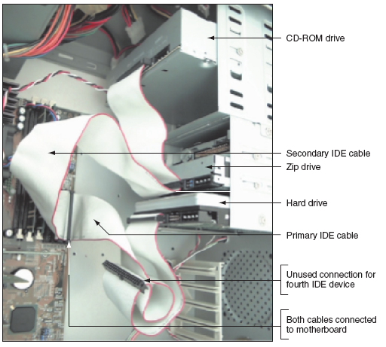
Figure 1-20 This system has a CD-ROM and a Zip drive sharing
the secondary IDE cable and a hard drive using the primary IDE cable
Courtesy: Course Technology/Cengage Learning

Slide 27
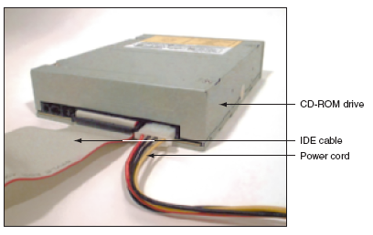
Secondary Storage (cont’d.)
Optical drives
RW can write to a disk
ROM (read-only memory) can only read a disc
Figure 1-22 This CD drive is an EIDE device and connects to the motherboard by way of an IDE data cable
Courtesy: Course Technology/Cengage Learning

Slide 28
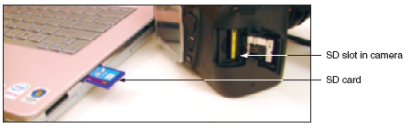
Secondary Storage (cont’d.)
USB flash drives and memory cards
Popular, nonvolatile flash memory chips
Compact; easy to use; currently hold up to 64 GB of data
Figure 1-24 Most laptops have a memory card slot that can accommodate an SD card
Courtesy: Course Technology/Cengage Learning

Slide 29
Motherboard Components Used For Communication Among Devices
Traces
Fine lines on top and bottom of the motherboard’s surface
Bus
System of pathways, transmission protocols
Data bus
Carries the data

Slide 30
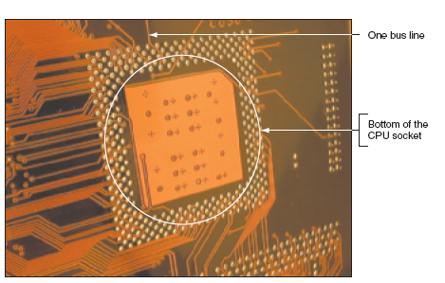
Figure 1-27 On the bottom of the motherboard, you can
see bus lines terminating at the CPU socket
Courtesy: Course Technology/Cengage Learning

Slide 31
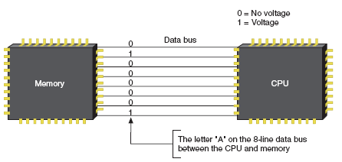
Motherboard Components Used For Communication Among Devices (cont’d.)
Binary data corresponds to voltage on the line
Data bus sizes today
16, 32, 64, 128, 256 bits wide
Some use error checking bit
Figure 1-28 A data bus has traces or lines that carry voltage interpreted by the CPU and other devices as bits Courtesy: Course Technology/Cengage Learning

Slide 32
Motherboard Components Used For Communication Among Devices (cont’d.)
Data path size
Width of a data bus
Motherboard can have more than one bus
Main motherboard bus
Communicates with CPU, memory, chipset
Buses for expansion slots:
PCI (Peripheral Component Interconnect)
AGP (Accelerated Graphics Port)

Slide 33
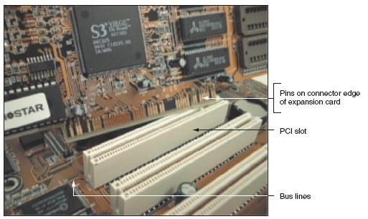
Figure 1-30 The lines of a bus terminate at an expansion slot where they connect to pins that connect to lines on the expansion card inserted in the slot
Courtesy: Course Technology/Cengage Learning

Slide 34
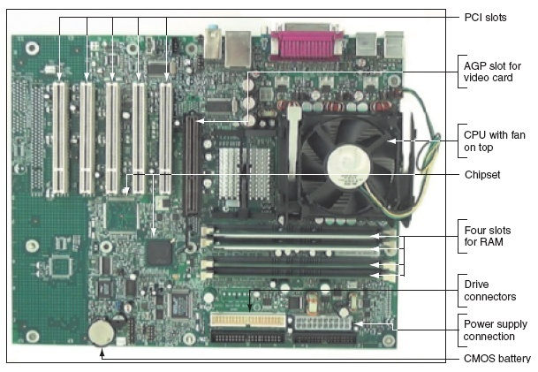
Figure 1-31 The one AGP slot used for a video card is set farther from the edge of the board than the PCI slots
Courtesy: Course Technology/Cengage Learning

Slide 35
Motherboard Components Used For Communication Among Devices (cont’d.)
System clock
Dedicated to timing motherboard chip activities
Quartz crystal generates oscillation
Devices work according to beats (or cycles)
Clock speed measured in hertz (cycles/second)
One megahertz (MHz): one million cycles per second
One gigahertz (GHz): one billion cycles per second
Common ratings for motherboard buses
2600 MHz, 2000 MHz, 1600 MHz, 1333 MHz, 1066 MHz, 800 MHz, 533 MHz, or 400 MHz
Range of CPU speeds: 166 MHz to 4 GHz

Slide 36
Expansion Cards
Some names for circuits mounted in expansion slots
Circuit cards, adapter boards, expansion cards, cards
Cards that connect the CPU to an external device
Video: provides a port for the monitor
Sound: provides ports for speakers and microphones
Network: provides a port for a network cable
Modem: provides ports for phone lines
Determine a card’s function by identifying its port

Slide 37
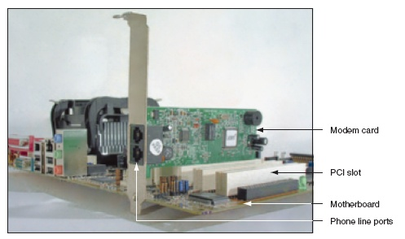
Figure 1-32 This adapter card is a modem card and is
mounted in a PCI slot on the motherboard
Courtesy: Course Technology/Cengage Learning

Slide 38
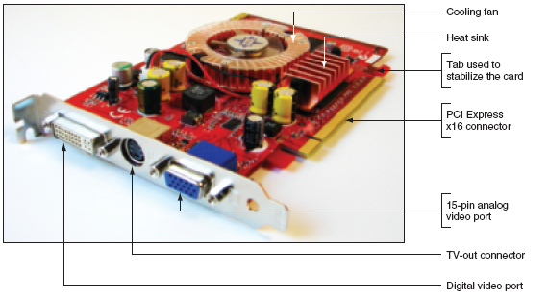
Figure 1-34 The easiest way to identify this video card is to look at the ports on the end of the card
Courtesy: Course Technology/Cengage Learning

Slide 39
The Electrical System
Power supply
Most important electrical component
Converts AC voltage external source to DC voltage
Reduces voltage from 110-120 volts to 12 volts or less
Runs a fan to cool the inside of the computer case
Temperatures > 185° F (85° C) can cause component failure
Motherboard has 1 or 2 connections to power supply

Slide 40
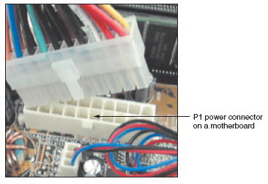
Figure 1-36 The motherboard receives its power from the power supply by way of a 20 or 24-pin connector called the P1 connector
Courtesy: Course Technology/Cengage Learning

Slide 41
Instructions Stored on the Motherboard and Other Boards
BIOS (basic input/output system)
Data and instructions stored on ROM chips
ROM BIOS chips: type of firmware
Three purposes served by motherboard ROM BIOS
System BIOS: manages simple devices
Startup BIOS: starts the computer
CMOS setup: changes motherboard settings
CMOS RAM: includes date, time, port configurations
Flash ROM
ROM chips that can be overwritten

Slide 42
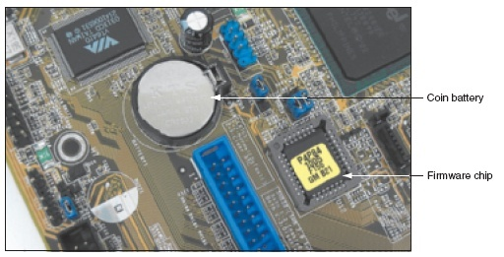
Figure 1-37 This firmware chip contains flash ROM and CMOS RAM; CMOS RAM is powered by the coin battery located near the chip
Courtesy: Course Technology/Cengage Learning

Slide 43
Summary
A computer comprises hardware and software
Main functions
Input, output, processing, storage
Data stored in a binary format (one or zero, on or off)
Input/output devices
Keyboard, mouse, printer, monitor
Motherboard (system board)
Contains CPU, access to other circuit boards, peripherals

Slide 44
Summary (cont’d.)
Primary storage (RAM): volatile
Secondary storage: nonvolatile
Parallel and serial ATA standards
Enable secondary storage devices to interface with the motherboard
Computer bus
System of communication pathways, protocols
ROM BIOS
Helps start PCs; manages simple devices; changes some motherboard settings

